Slide 1
Please stick or paste a photograph of yourself here!
Autumn Challenge 2023
Student Name:
Company:
Tutor:

Slide 2
Autumn Challenge
2023
Dear Student,
Welcome to the Q3 Academy Langley Autumn Challenge! The purpose of this booklet is to give you an opportunity to continue your Pursuit of Excellence (one of Q3 Academy’s core ideals) during the Autumn term.
At Q3 Academy, we have an ethos that runs through everything that we do. The letter ‘Q’ in our name represents the Latin word ‘Quaerere’ – meaning ‘seek after’ or ‘search for.’
The name Q3 represents three high ideals:
To seek for that which is good.
To seek for that which is right.
To seek for that which is true.
As a result, we hope that you use the tasks in this booklet as an opportunity to seek truth, to discover goodness, and to showcase the right way to conduct yourself as a young person. Make sure that you do your absolute best in as many of the tasks as possible; we are really excited to see what you produce, and begin our Pursuit of Excellence together.
Parents/carers – we would like to ask that you monitor your child’s progress, sign when tasks are completed, and support your child in any way possible – our Pursuit of Excellence is a group effort, and we are stronger together.
Kind Regards,
Mr. P. Lee
(Headteacher, Q3 Academy Langley)

Slide 3
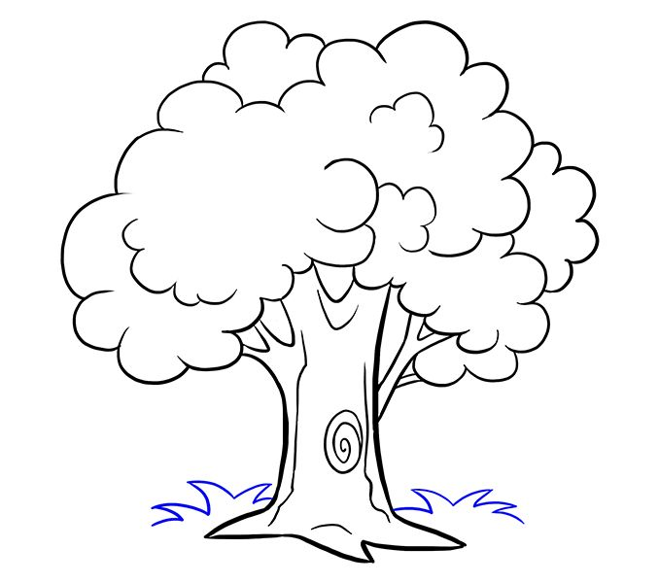
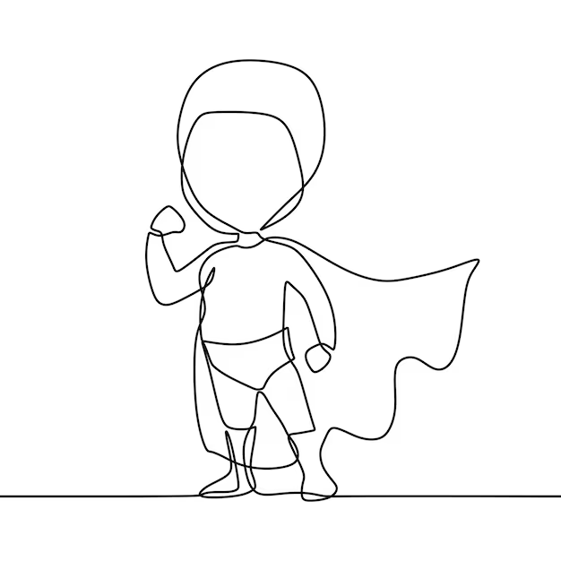
Autumn Challenge 2023
A. Visit a live sporting event, the theatre or watch a film at the cinema. | B. Plan a three course meal, design your menu and make at least one of the dishes. | C. Write a book review of your favourite book. Include a description and make your opinion clear.
D. Go on a family walk. Try to spot at least 5 different animals or plants. | E. Do a good deed for a neighbour or family member. For example, you may: wash their car, get some shopping for them, walk their dog, or even just ask them about their day or interests. | F. Create a cartoon strip. This could be based on the adventures of Captain Langley – a new superhero in the local area.
G. Go on a litter pick with a friend in your local area. Don’t forget your gloves and bin bag! | H. Learn the capital cities of 10 countries. Create a fact file on one of these cities including at least 3 interesting facts. | I. Learn a magic trick and perform it in front of a family member.

Slide 4
Autumn Challenge Task Completion
Task: | Task: | Task: | Task:
Date completed: | Date completed: | Date completed: | Date completed:
Additional information: | Additional information: | Additional information: | Additional information:
Signed by parent/carer: | Signed by parent/carer: | Signed by parent/carer: | Signed by parent/carer:

Slide 5
Autumn Challenge Task Completion
Please attach any additional evidence of the completion of your Autumn Challenge Tasks here! This may include: photographs, tickets, receipts, testimonials, leaflets or posters – anything that shows you have engaged with the activity!
Please prepare this booklet for the first week back when we return to the Academy after the Christmas holiday!

Slide 6
Autumn Challenge Task Completion
Additional Information – Continued.
Please prepare this booklet for the first week back when we return to the Academy after the Christmas holiday!

Slide 7
Autumn Challenge Task Completion
Additional Information – Continued.
Please prepare this booklet for the first week back when we return to the Academy after the Christmas holiday!

Slide 8
Autumn Challenge Task Completion
Additional Information – Continued.
Please prepare this booklet for the first week back when we return to the Academy after the Christmas holiday!

